Slide 1
Creative Arts – Media Arts
Year 9 and 10

Slide 2
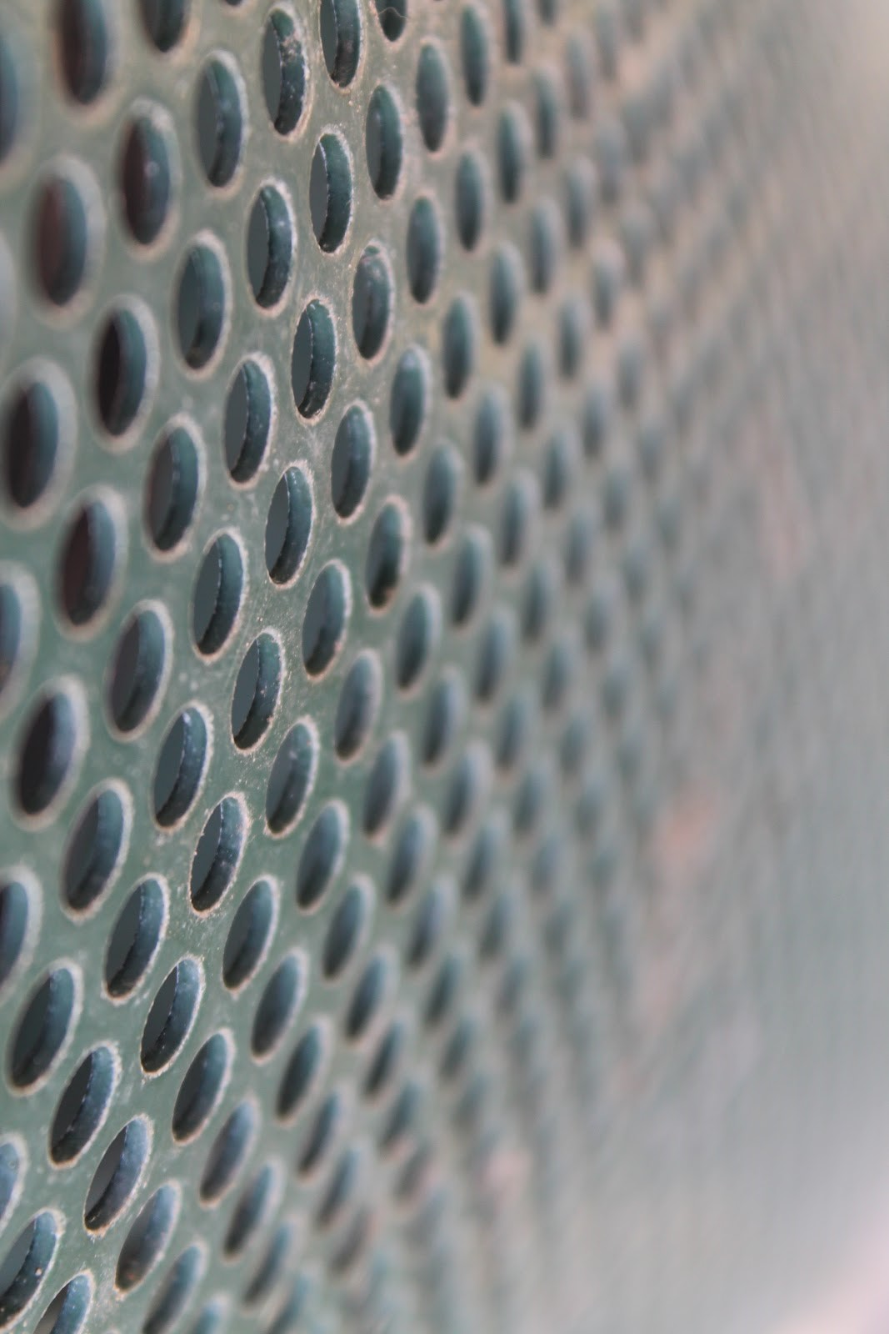
What do you do?
Make photographs, magazine covers and film.
Lean analogue and digital techniques.
Consider and respond to Media issues and conventions.
Respond to project briefs.

Slide 3
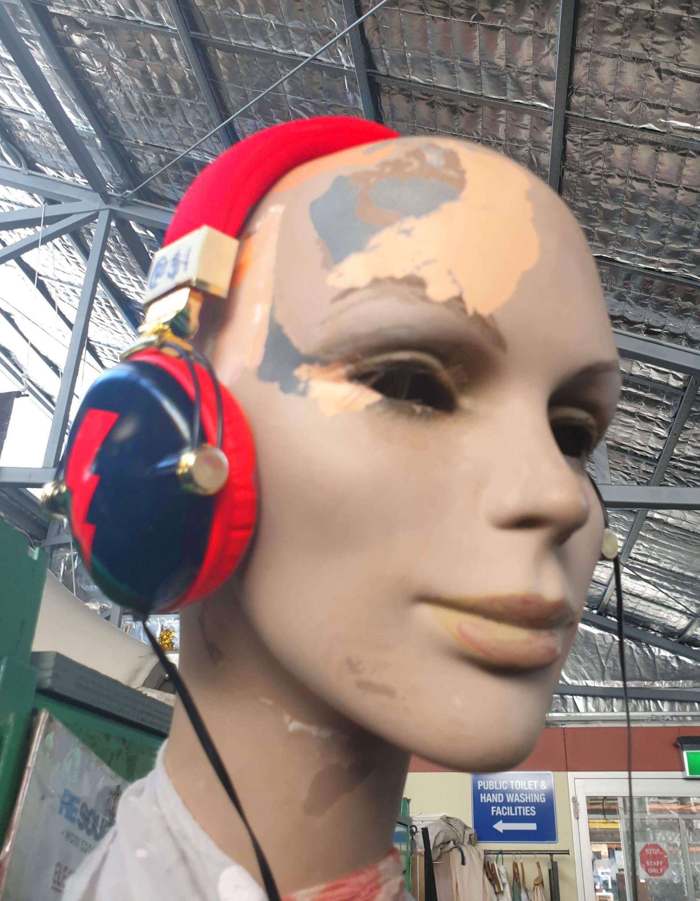
What do you do?
For assessment you will be required to submit a portfolio of finished media artworks, a sketchbook detailing idea generation and written responses to genres and conventions.

Slide 4
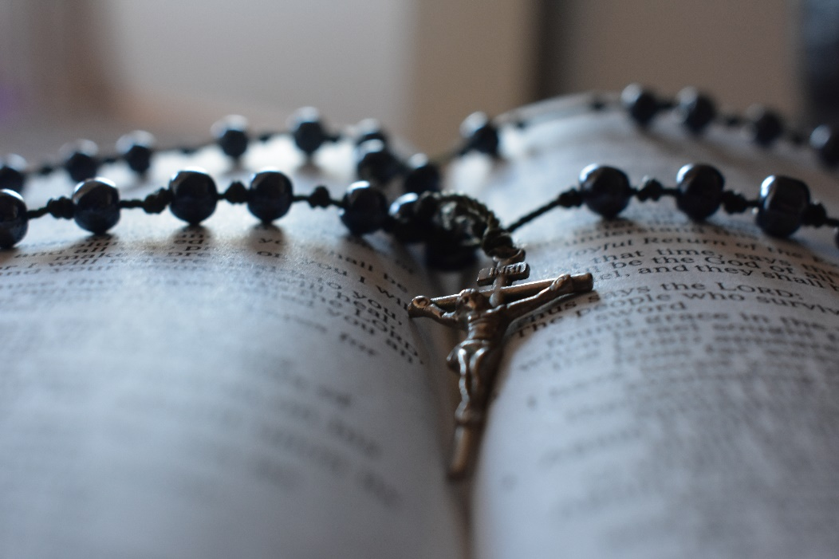
What you need?
The ability to work independently and collaboratively.
A willingness to try new things.
A desire to use technology to make artworks.

Slide 5
Find out more…
Please feel free to contact Mr Mike O’Brien, Head of Creative Arts, at mobrien@dominic.tas.edu.au

